Slide 1
One sentence pitch
LOGO
Image of Product
(Website/App/Game)
Website or link to the store

Slide 2
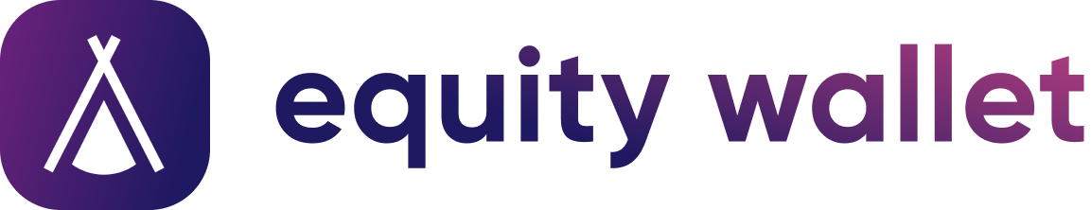
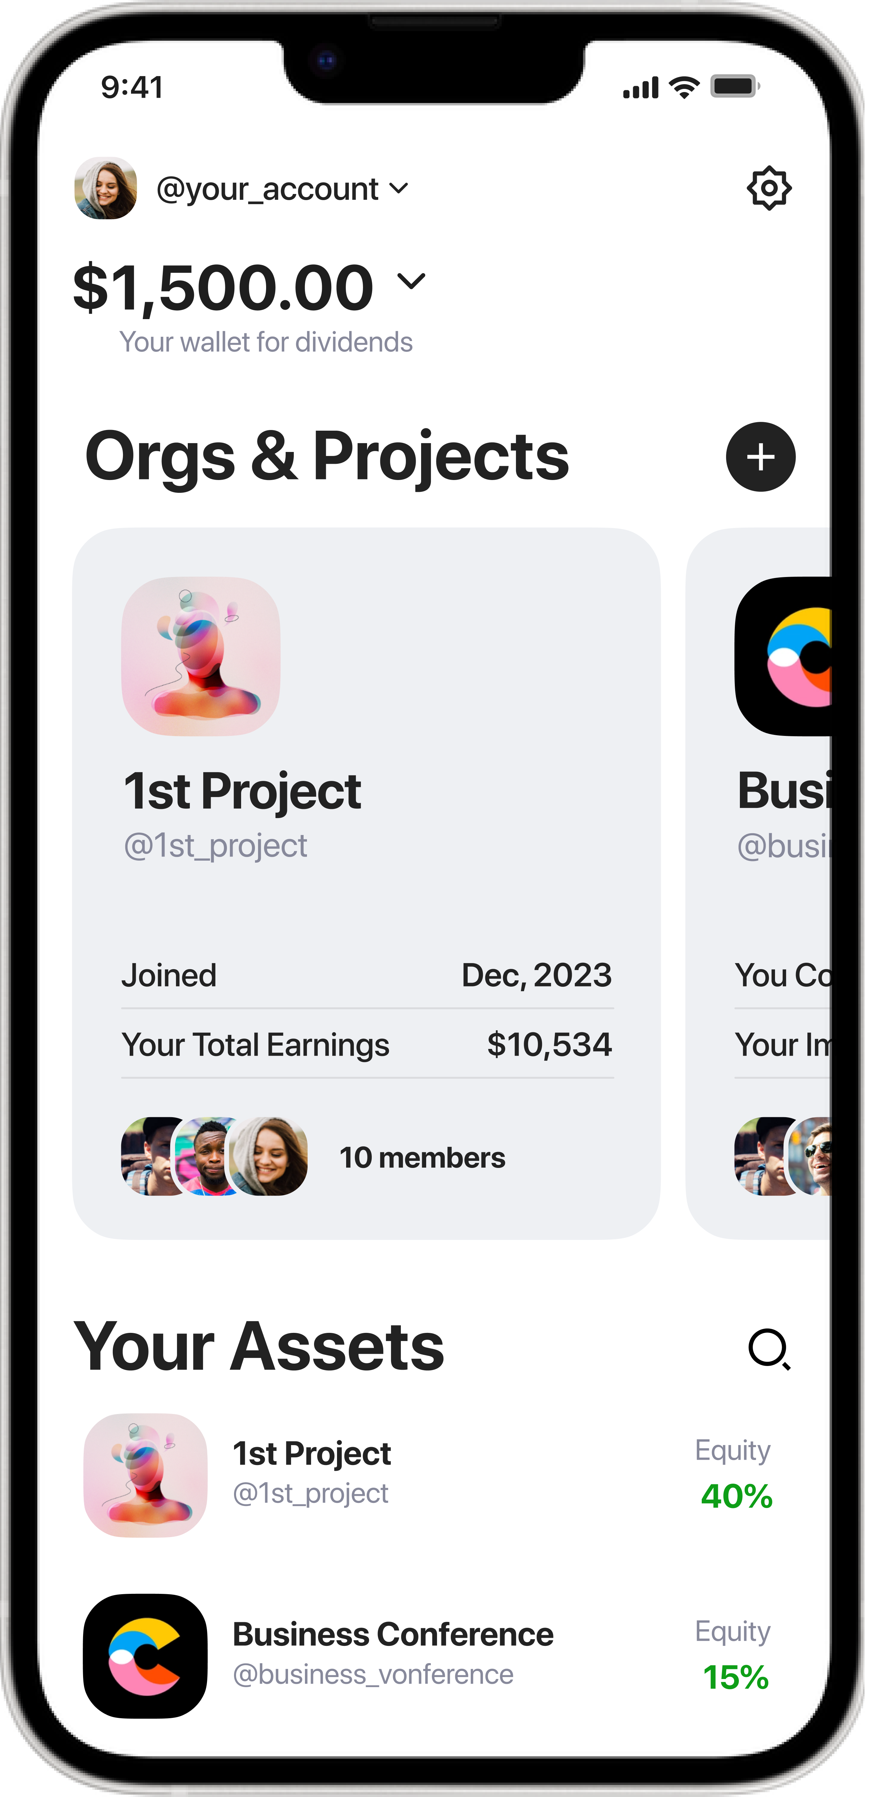
Platform to own and manage equity on paper blockchain.
https://equitywallet.org
Example

Slide 3
Problem
Describe the problem you solve

Slide 4
Equity on paper sucks
🤥 Expensive and complicated
🤥 Doesn’t work for small projects
🤥 Hard to sell & transfer
🤥 Can be manipulated
🤥 Not linked directly to a project performance
Owning equity in a project means to benefit from its performance. Lack of direct link with project performance makes possible cheating with company’s funds, faking financial reports, misleading
Example

Slide 5
Solution
How do you propose to solve the problem?

Slide 6
Solution
Store shareholders’ equity on blockchain to avoid any manipulation and links their equity to project’s performance via smart contracts.
Example

Slide 7
Product
Describe and show your product

Slide 8
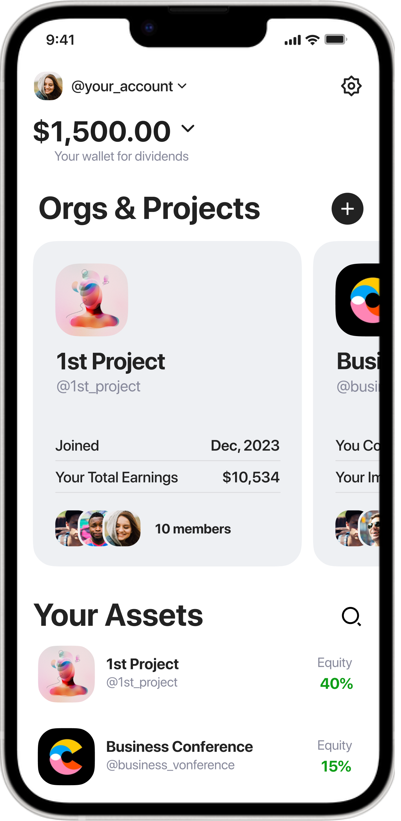
Product
App where shareholders can get, store, send, sell equity of projects they related with and get dividends from project’s performance pro-rata their equity.
See performance, raise money and invite new members to these projects.
Example

Slide 9

How Equity Wallet inevitably links shareholders’ equity with project’s performance
Project’s Income
Every project has a wallet to accept crypto
Every equity holder of a project has it’s personal crypto wallet
Smart contracts ensure revenue distribution between wallets automatically pro-rata shareholders’ equity
Project’s Wallet
87ksws77…89js16zx
Io762dcP…0QnM6ydf
u62cn001…tt4z1oJg
Equity holder Wallet
Equity holder Wallet
Equity holder Wallet
Example

Slide 10
Benefits
How customers will benefit from using your product?

Slide 11




Benefits from storing your equity via Equity Wallet on blockchain
Total transparency
All project financials are visible to you: treasury, cashflow, shares etc.
Inevitability of Payouts
Automatic revenue distribution according to your equity is ensured by Smart Contracts — self-executing programs on blockchain.
Inability to manipulate
Blockchain technology makes it impossible to delete, change or fake any project’s data including your % of equity.
Easy to Transfer
Sell or send your equity in one tap.
Example

Slide 12
Why Now
Give arguments

Slide 13
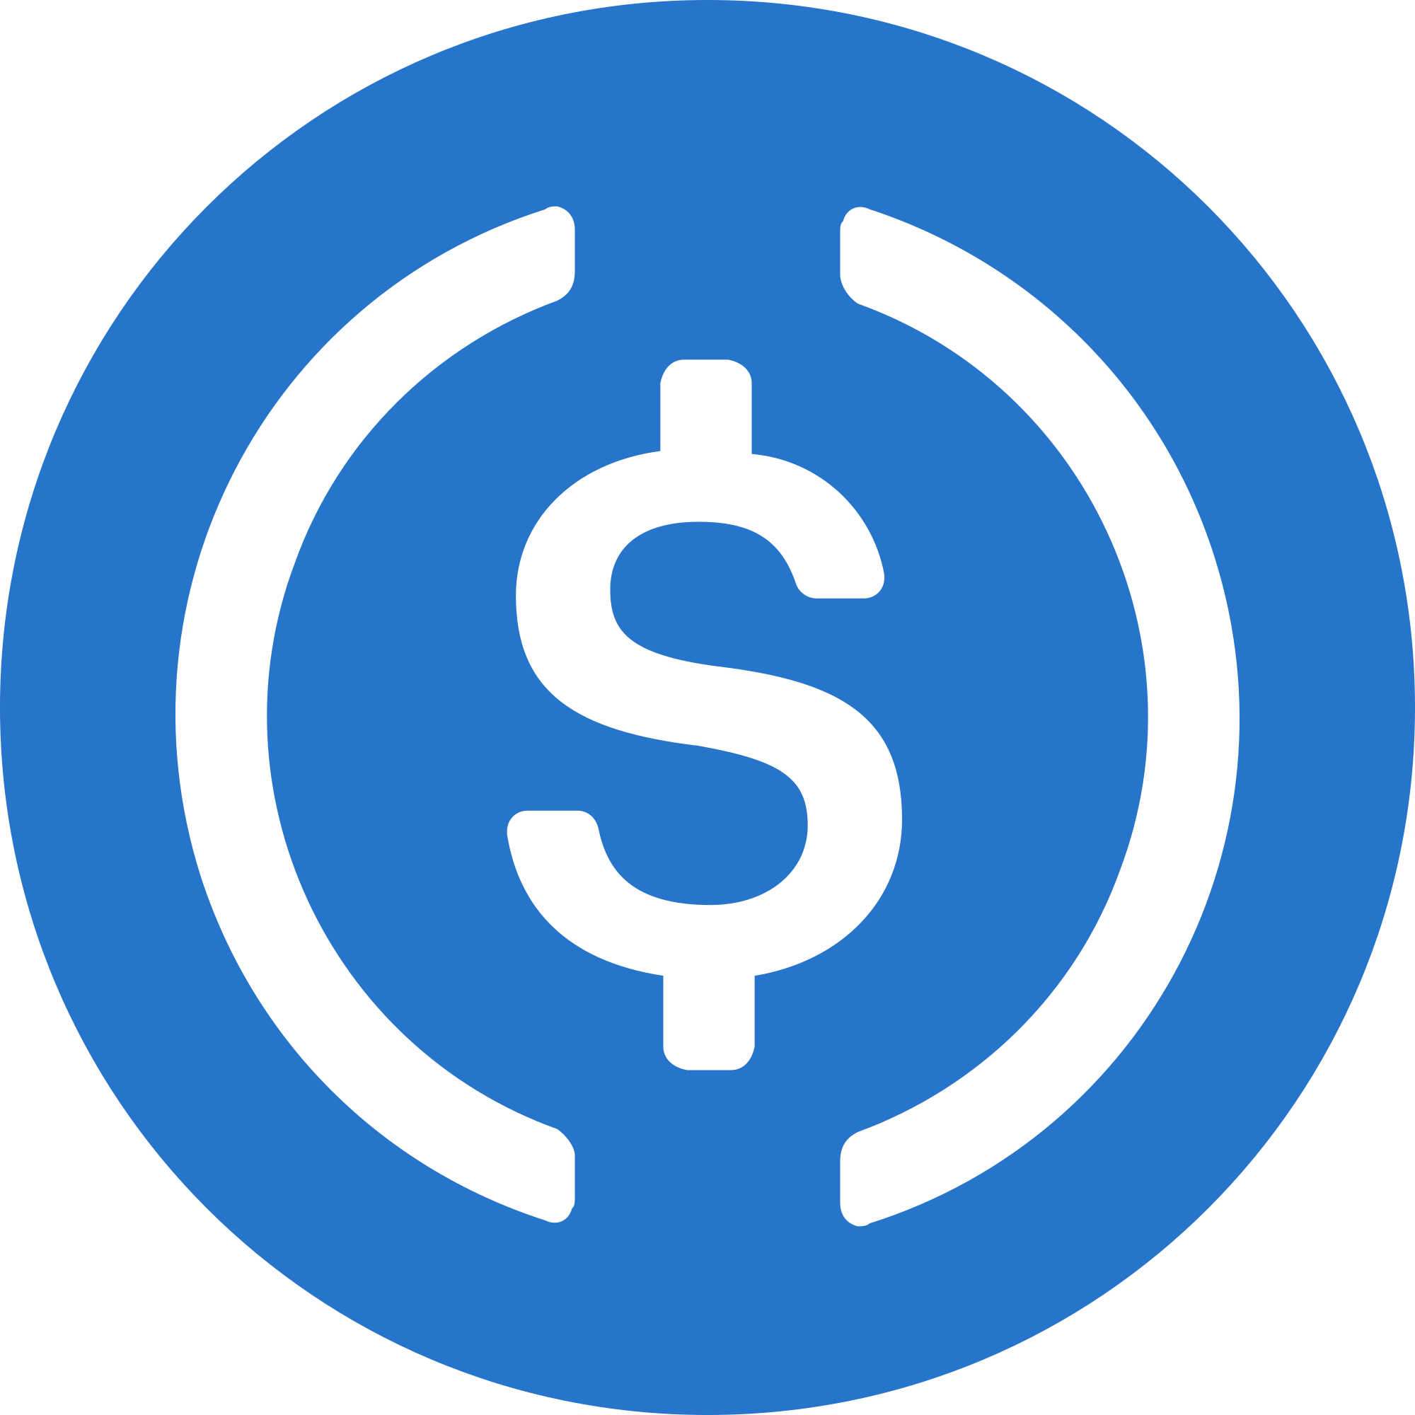
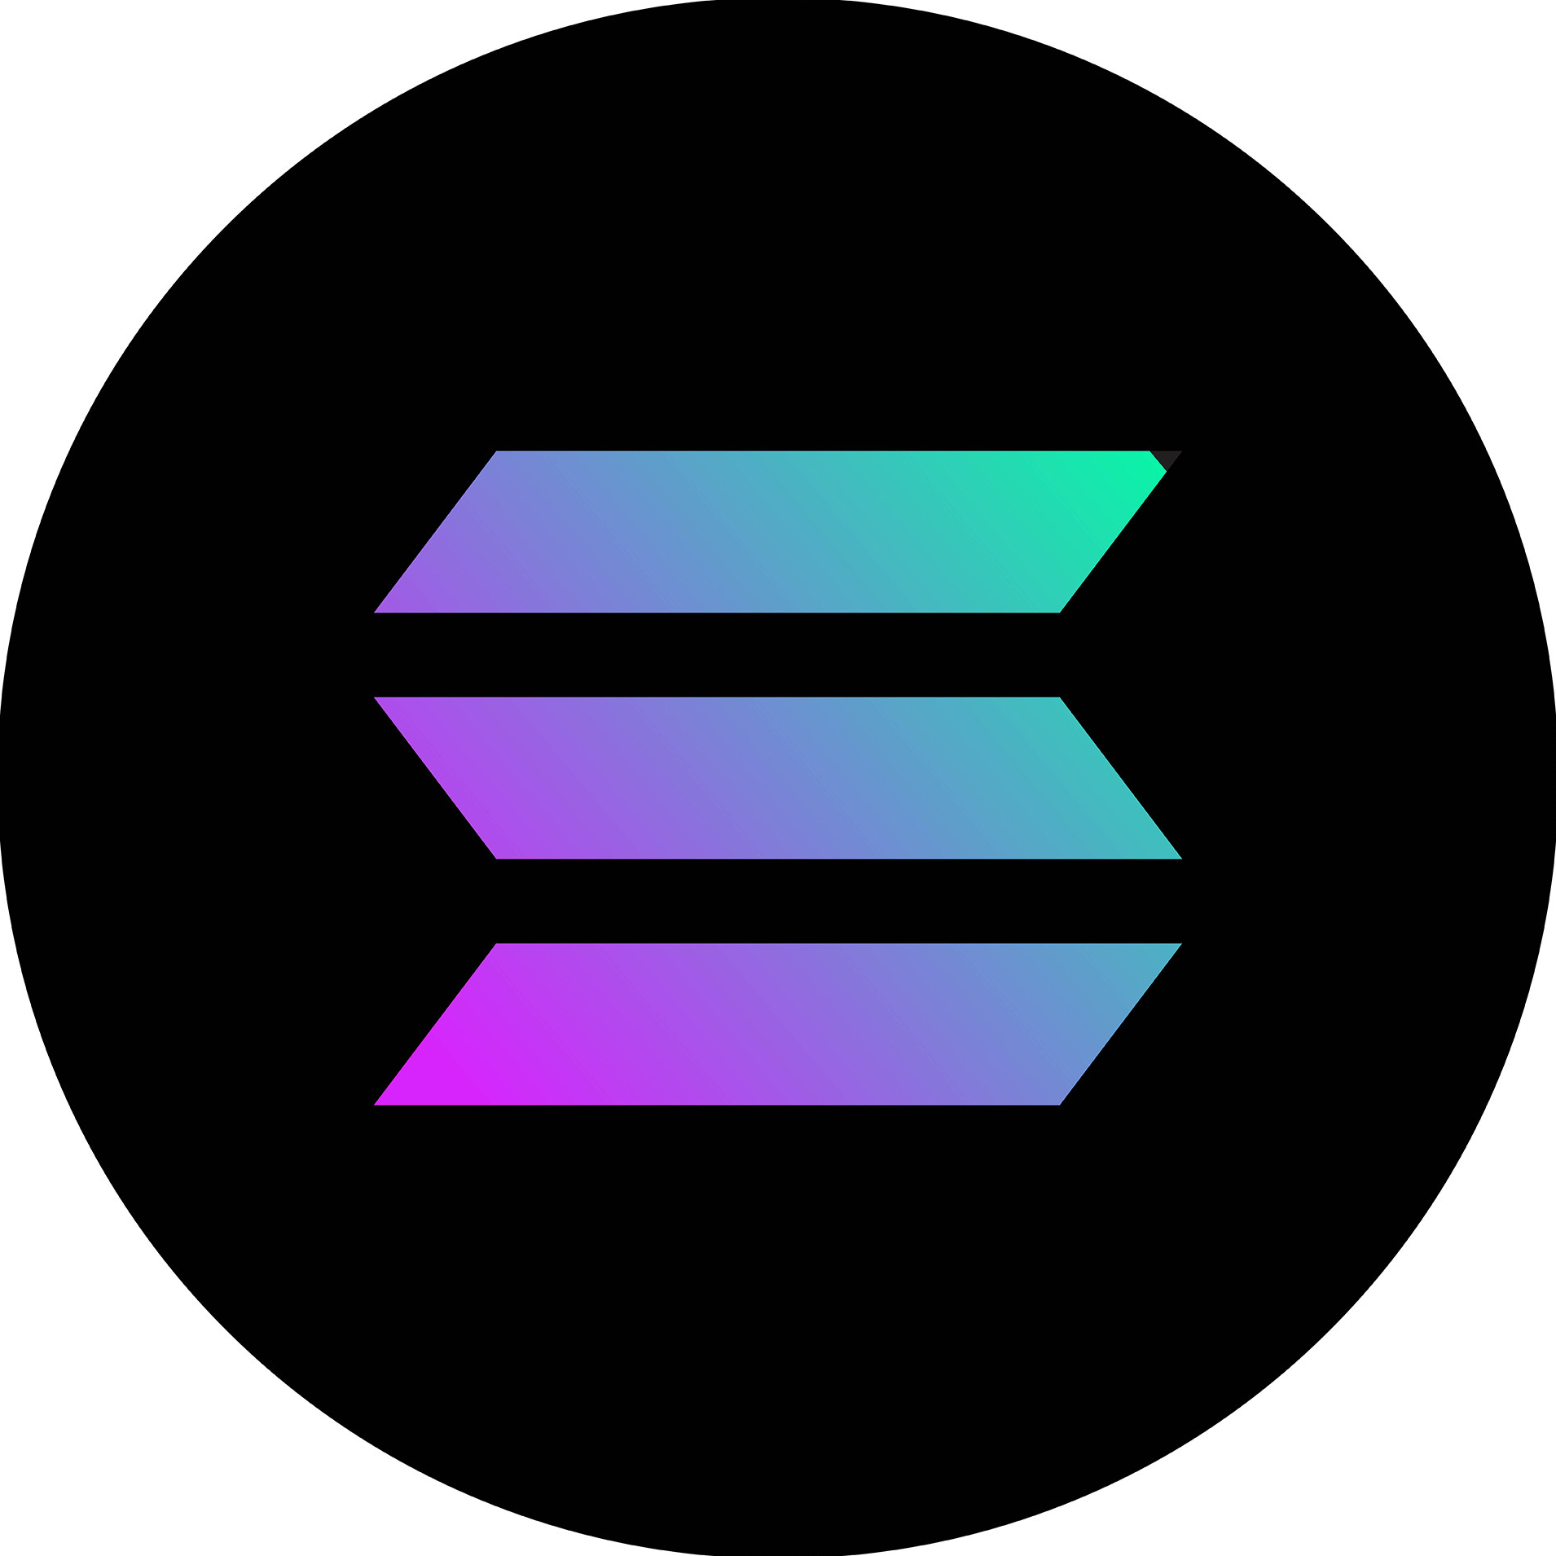
Why now
USDC and other stablecoins are widely accepted as a payment method for goods and services.
Nearly 75% of retailers plan to accept either cryptocurrency or stablecoin payments within the next 2 years.
Blockchain became fast and affordable ($0.00025 per transaction) and is proven as a transparent and indisputable ledger
Example

Slide 14
Market
TAM
SAM
SOM
Serviceable Obtainable Market
Serviceable Available Market
Total Available Market

Slide 15
Market
$26T
TAM
$3B
SAM
$500M
SOM
Small projects
accepting crypto
Private businesses accepting crypto
Total Equity Valuation of Private businesses
16% of small businesses have between one and 19 employees
$8B Crypto payment volume
7.77% average net margin
5X valuation multiplier
$67T Global revenue of private companies
7.77% average net margin
5X valuation multiplier
Example

Slide 16
Business Model
How are planing to earn money?

Slide 17

Business Model
Product is free to use
We take 1% fee when equity is sold
$500M
1% commission
$5M revenue
Total valuation of small projects accepting crypto
In 2024
Example

Slide 18
Big Picture
How your product is going to change the current thing?

Slide 19
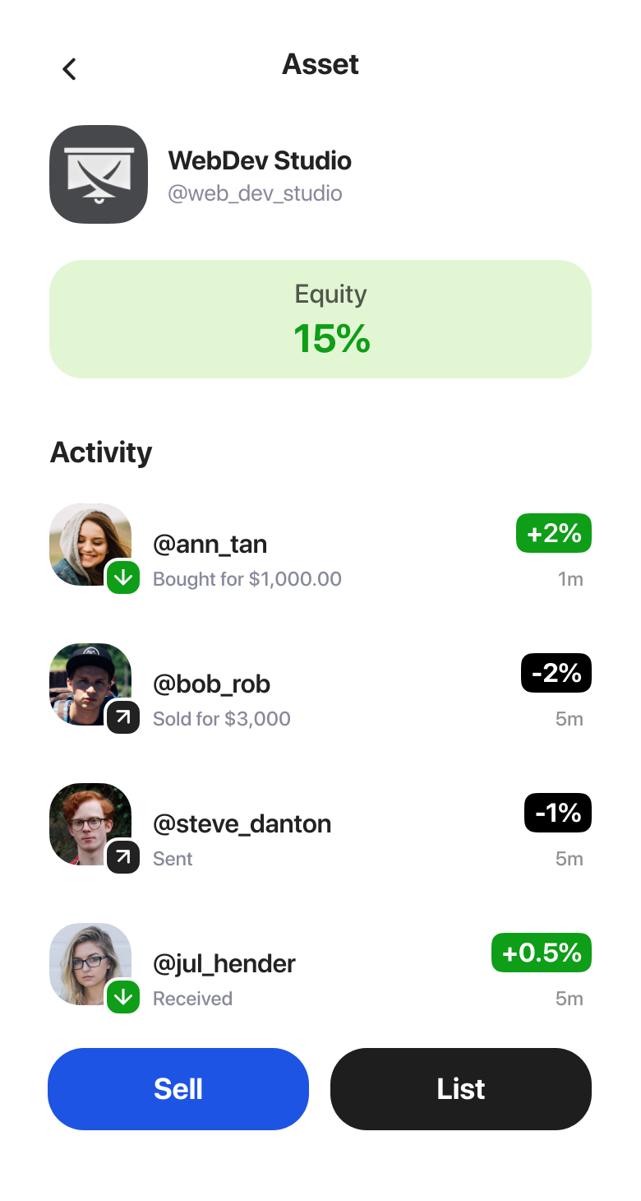
‘Nasdaq’ of the future
Transferring equity of private organizations and projects between people as easy as sending messages
Example

Slide 20
Team
Show your team and describe what you’ve done before.

Slide 21
What do you need
Answer this simple question.

